Slide 1
Magnetically Coupled Ball Drive
Phase 1 Report
MCBD Senior Design Team:
Anthony Bianco
Sophie Cho
Ryan Levine
Matthew Rice
Brian Rojas

Slide 2
Overview
Project Description
Societal & Customer Needs
State-of-the-Art Technologies
Concept Generation & Selection
Technical Analysis
Project Plan

Slide 3
Overview
Project Description
Societal & Customer Needs
State-of-the-Art Technologies
Concept Generation & Selection
Technical Analysis
Project Plan

Slide 4
Project Description
Goals & Objectives
The Magnetically Coupled Ball Drive (MCBD) project focuses on the design improvement of a ball drive, which allows for the holonomic motion of driven platforms.
This project is motivated by the desire to resolve the issues caused by an external support structure.
Efficiency of ball drive can be negatively impacted by collection of debris increasing rolling resistance.
Four major goals for this project:
Develop design to be prototyped
Build prototype
Develop test apparatus and methodology
Test prototype

Slide 5
Project Description
Major Challenges
Design Challenges
Support loads
Design for manufacturing ease
Move efficiently
Minimize slipping of drive and wheel
Maintain coupling via magnets during adverse conditions
Prototype/Testing Challenges
Prototyping ease impacted by design choices
Assembly is complex
A structure inside another that needs to be smooth and spherical
Creation of new testing apparatus and methodology

Slide 6
Overview
Project Description
Societal & Customer Needs
State-of-the-Art Technologies
Concept Generation & Selection
Technical Analysis
Project Plan

Slide 7
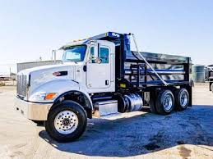
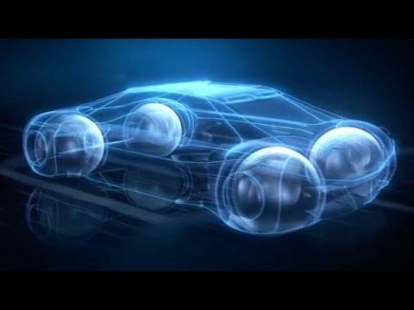
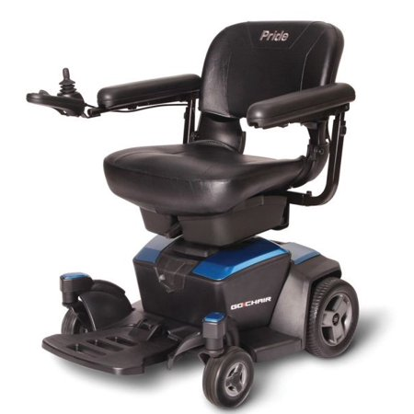
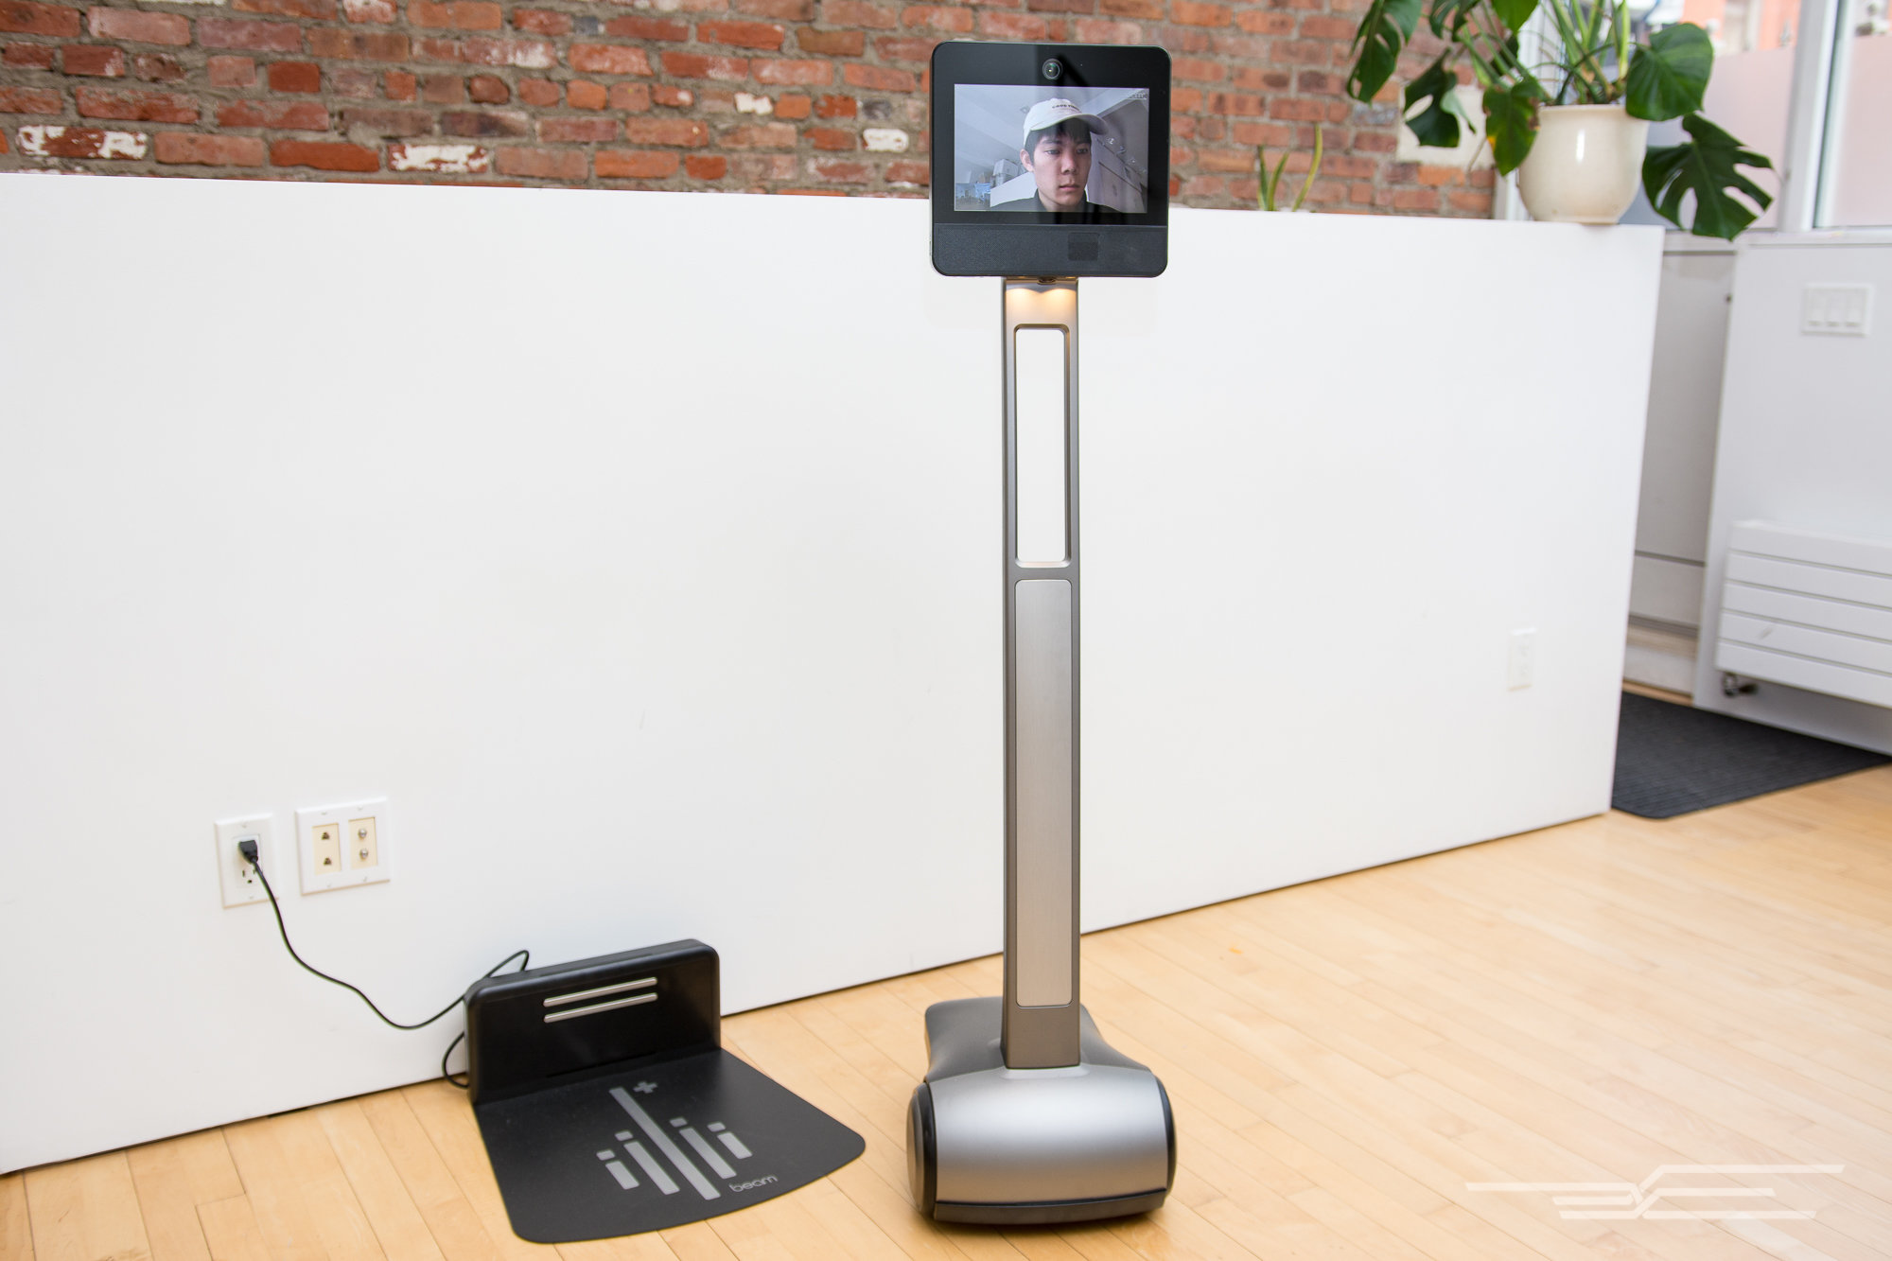
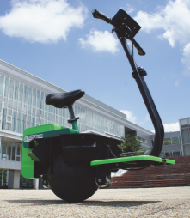
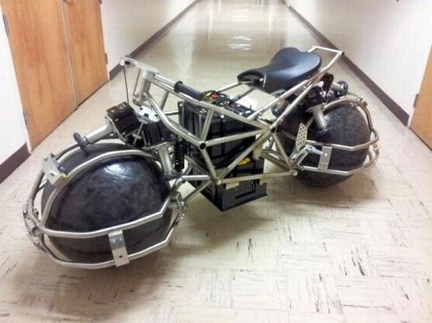
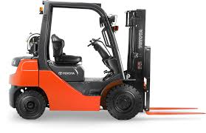
Societal Needs

Slide 8
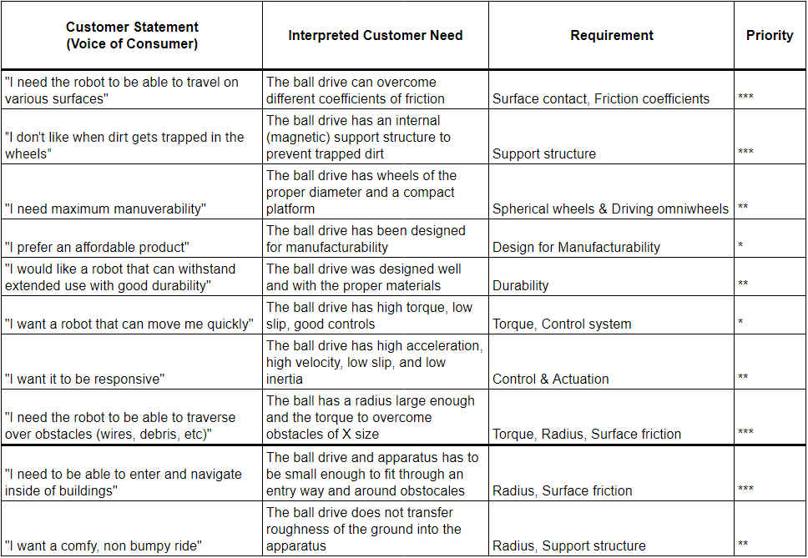
Customer Needs
Customer Voice Table

Slide 9
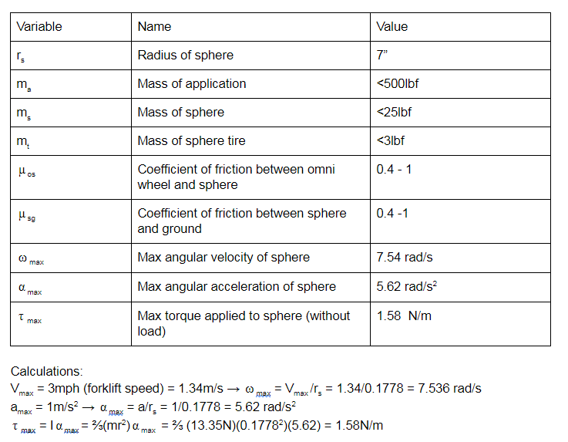
Specifications
Chosen Application - Wheelchair

Slide 10
Overview
Project Description
Societal & Customer Needs
State-of-the-Art Technologies
Concept Generation & Selection
Technical Analysis
Project Plan

Slide 11
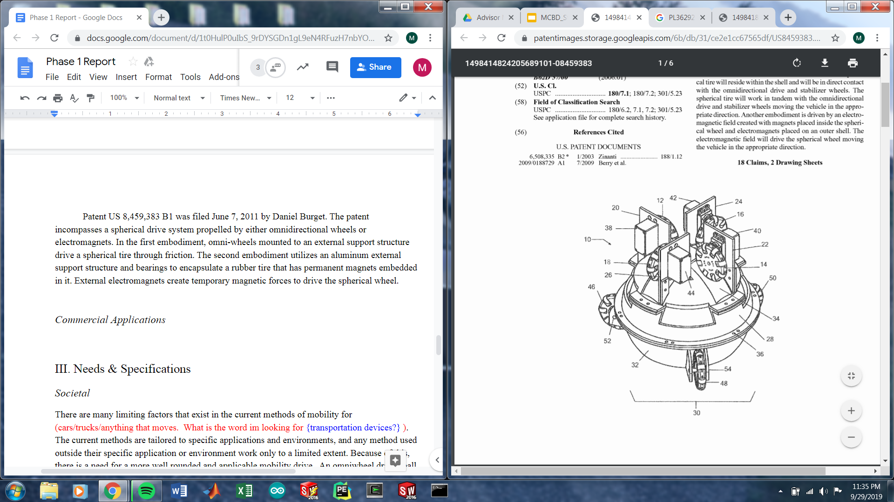
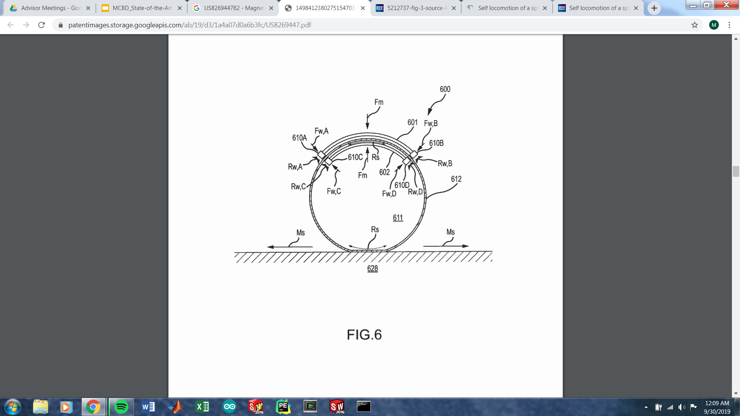
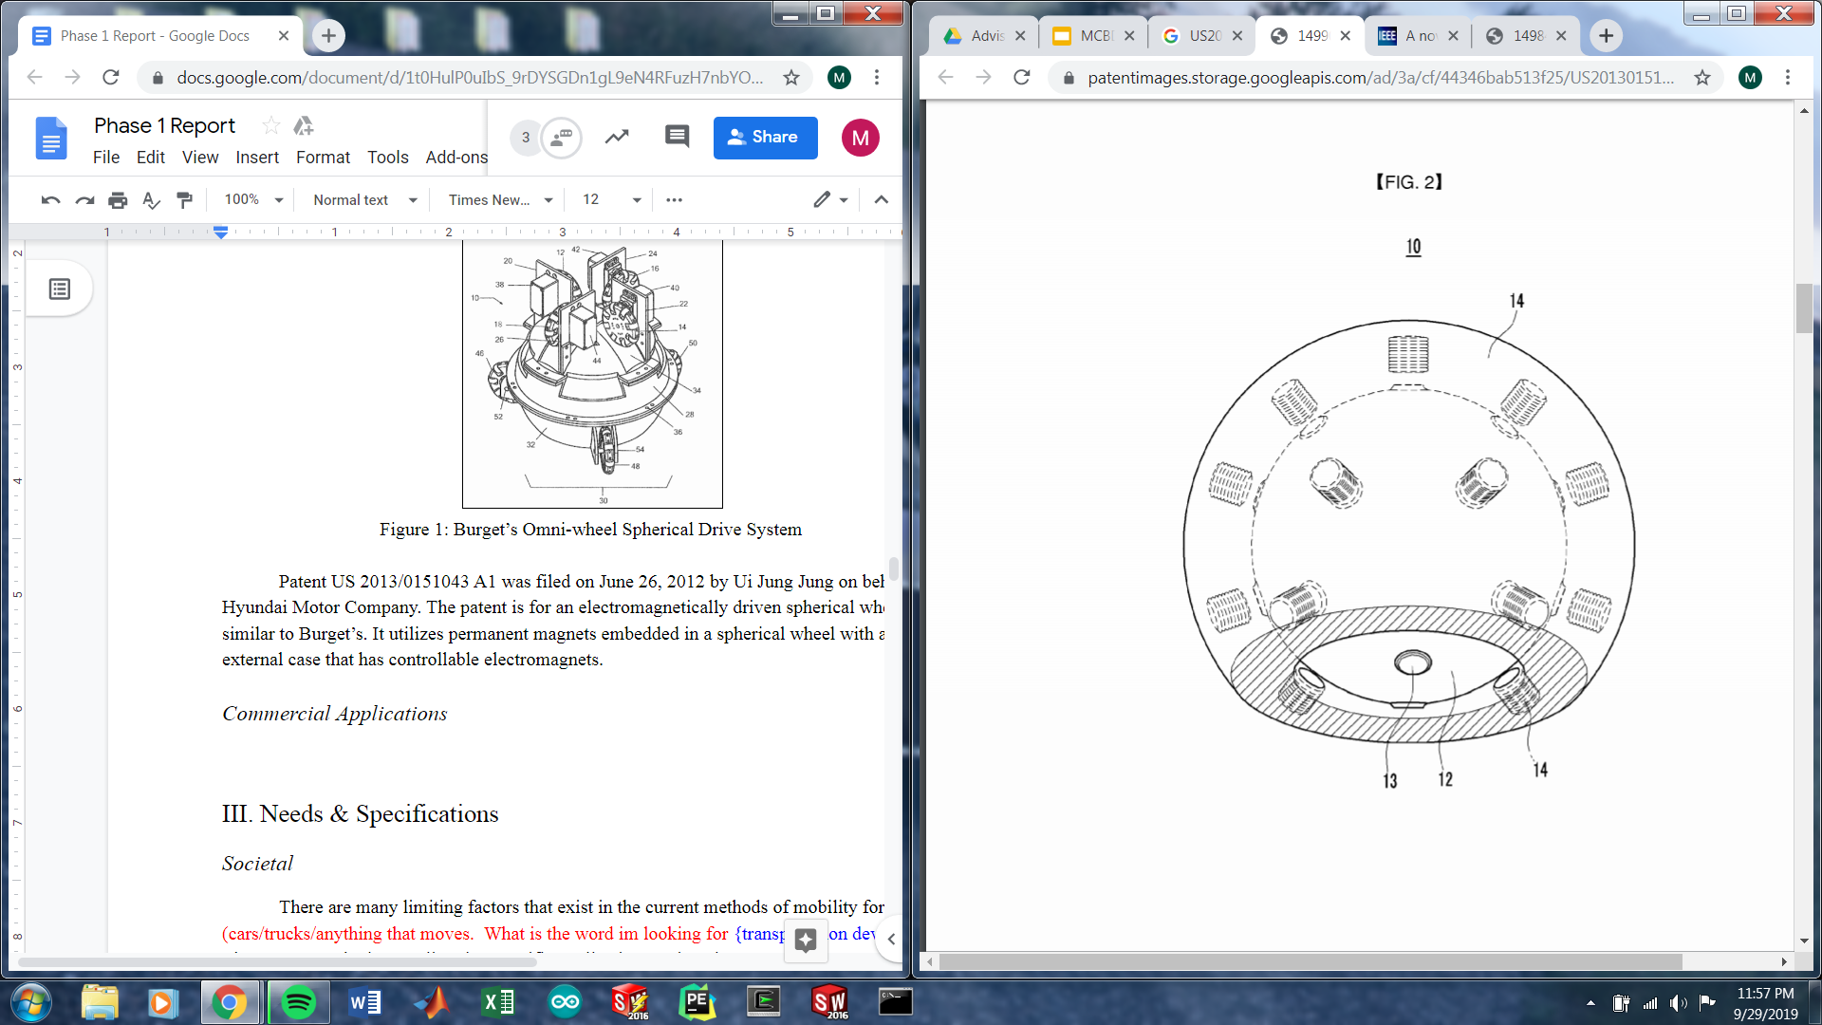
State-of-the-Art Technologies
Patents & Research Papers
US8,459,383B1-Burget
US8,269,447B2-Disney
US0,151,043A1-Hyundai
Notes:
Many patents for spherical induction drives but no commercial integration
Inefficient & high cost
Tight vulnerable air gap needs to be maintained
Disney patent on magnetic coupling
Clear desire in industry to implement spherical drives

Slide 12
Overview
Project Description
Societal & Customer Needs
State-of-the-Art Technologies
Concept Generation & Selection
Technical Analysis
Project Plan

Slide 13
Concept Generation
Concept Combination Table
Drive System | Spherical Wheel | Internal Structure
(OW) Omni-wheels (MOW) Magnetic omni-wheels (OC) Omni-chain (MOC) Magnetic omni-chain (IS) Induction sphere | (BAND) Multiple bands holding wheel together (RIGI) Rigid sphere with external tire/coating (FLEX) Flexible material sphere (SOCC) “Soccer ball” with varying materials (frame and panels) (INFL) Inflated wheel | (SP) Fully spherical (TH) Top hemisphere (BH) Bottom hemisphere (TB) Top/bottom hybrid (¾) Top ¾ sphere

Slide 14
Concept Generation
Concepts 1 to 7
Reference spherical wheel
Reference spherical wheel
Reference spherical wheel
1
2
3
4
Reference spherical wheel
Reference spherical wheel
5
6
7

Slide 15
Concept Generation
Concepts 8 to 15
Reference spherical wheel
Reference spherical wheel
Reference spherical wheel
8
9
10
11
12
13
14
15

Slide 16
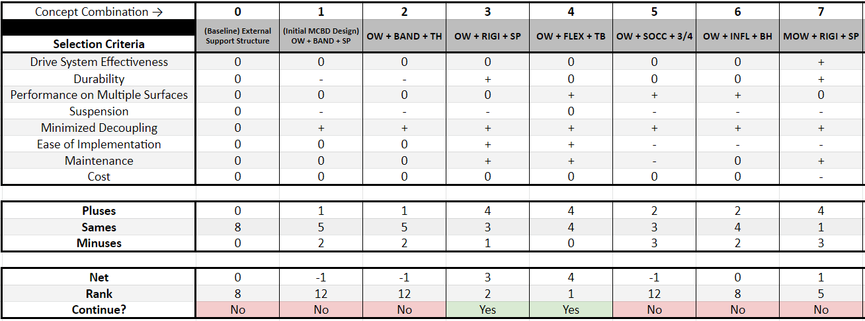
Concept Screening
Concepts 1 to 7

Slide 17
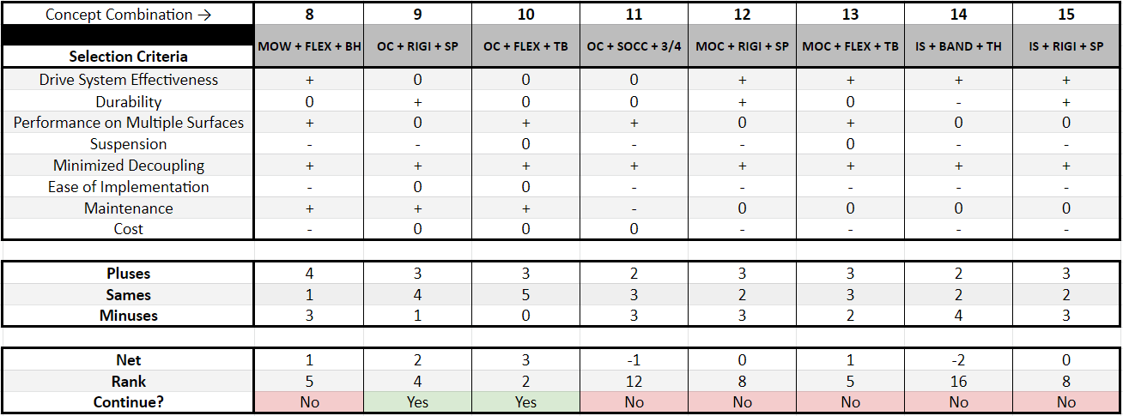
Concept Screening
Concepts 8 to 15

Slide 18
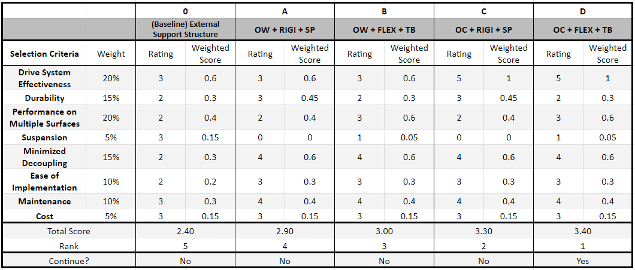
Concept Selection
Concept Selection Matrix

Slide 19
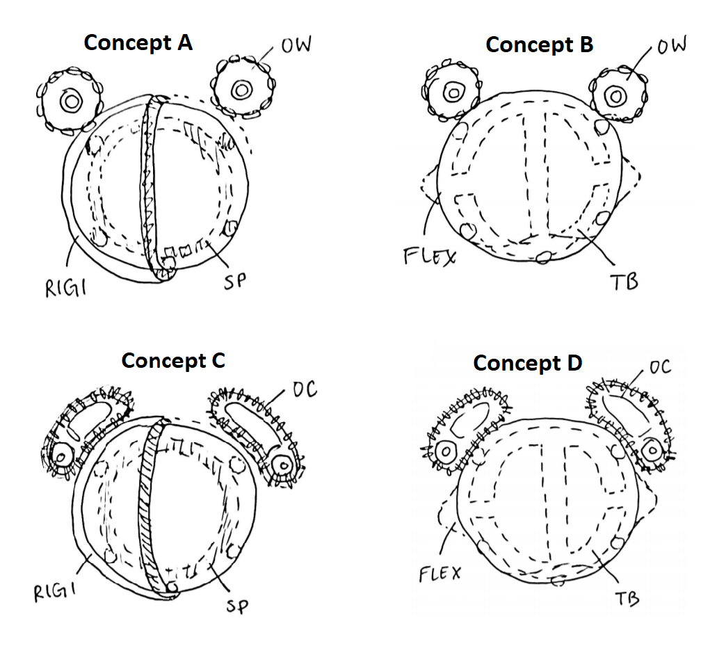
Concept Selection
Selected Concepts
Ranked #1

Slide 20
Overview
Project Description
Societal & Customer Needs
State-of-the-Art Technologies
Concept Generation & Selection
Technical Analysis
Project Plan

Slide 21
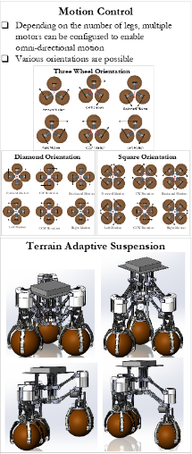
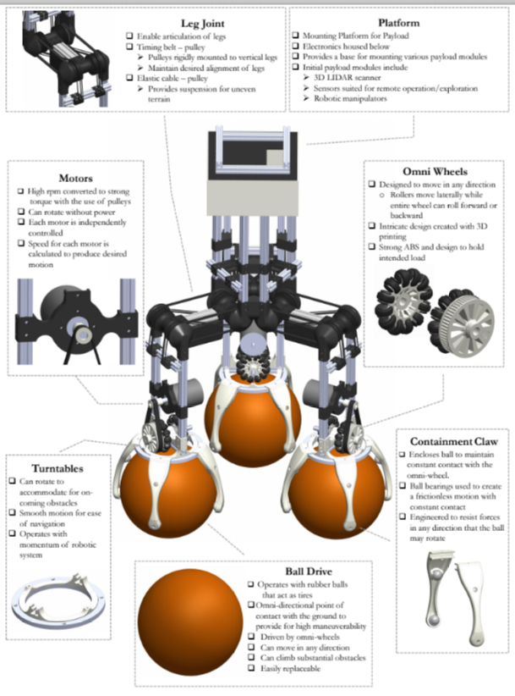
Technical Analysis
Previous Senior Design Research
2012-2013 Senior Design
2013-2014 Senior Design

Slide 22
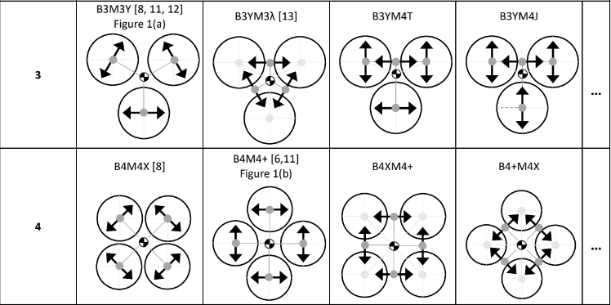
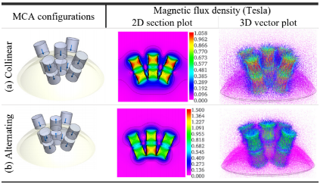
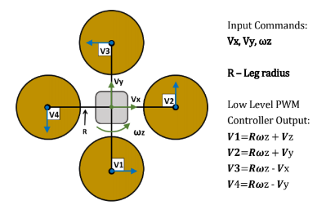
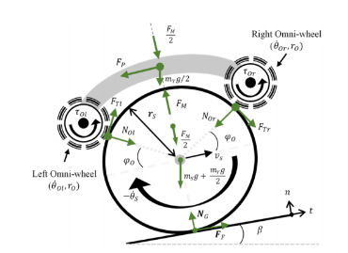
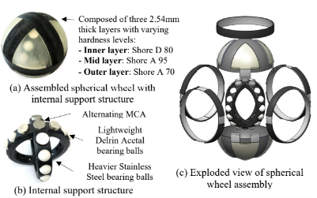
Technical Analysis
Previous Stevens Faculty Research
The pictures below are from published research by Stevens Faculty:
Biruk Gebre and Kishore Pochiraju
Research into ball drive configurations
Research into ball drive control
Research into proof of concept of a magnetically coupled ball drive

Slide 23
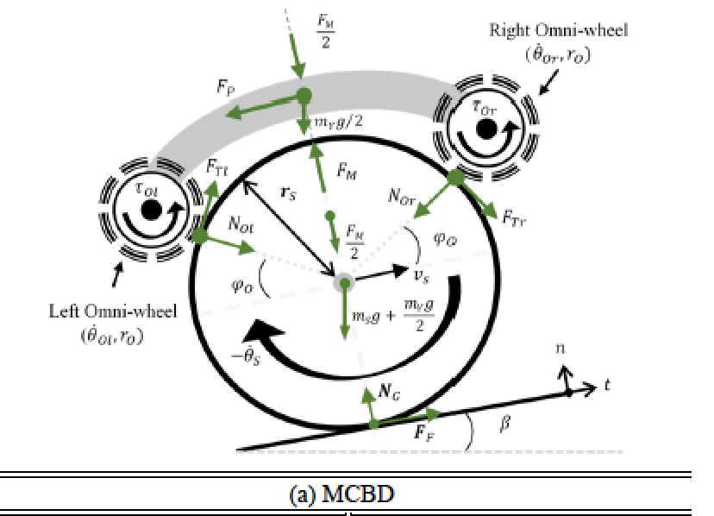
Technical Analysis
Governing Equations
F=ma
T = I𝜶
⍵ = v/r
𝜶 = a/r
F_{F}=μN
I=(⅔)mr²
E=𝝈/ε
F_{M}=Magnet Force

Slide 24
Overview
Project Description
Societal & Customer Needs
State-of-the-Art Technologies
Concept Generation & Selection
Technical Analysis
Project Plan

Slide 25
Project Plan
Deliverables
Phase 1
Phase 2
Phase 3
Research into existing technology
Society/customer needs
project statements
Concept selection
Concept Design
CAD Drawing
Design for Manufacturability
Technical Analysis
Finalize Design
Finalize Technical Analysis
Create alpha prototype

Slide 26
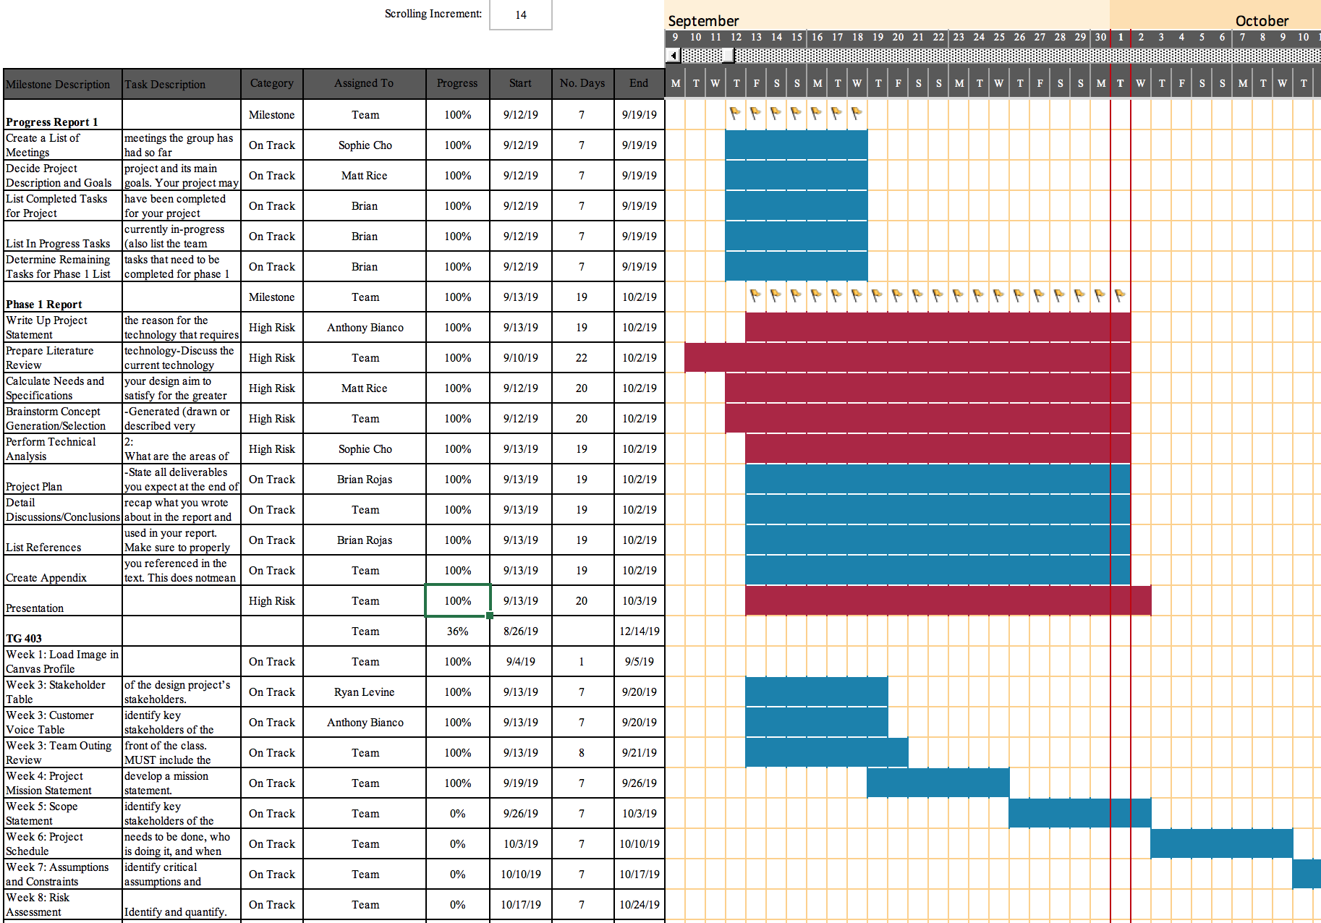
Project Plan
Gantt Chart

Slide 27
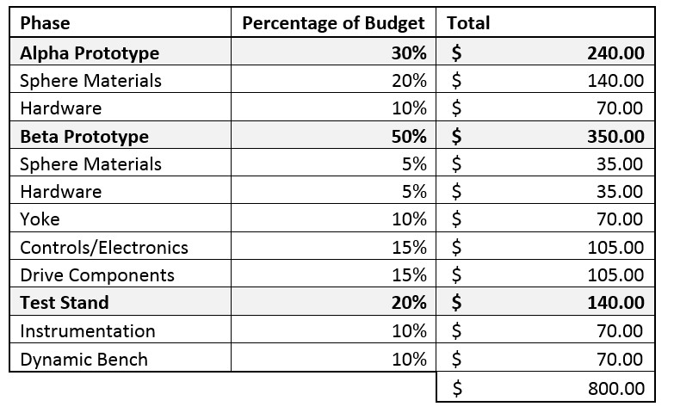
Project Plan
Budget

Slide 28
Picture References
Dump Truck: https://cdn1.commercialtrucktrader.com/v1/media/5d2dfbfb7b22cb0d25473fdc.jpg?width=512&height=384&quality=60
Scooter: https://iopscience.iop.org/article/10.1088/1742-6596/744/1/012211/pdf
Wheelchair: https://i5.walmartimages.com/asr/0e089dd1-d6a8-46bb-a500-3ae26fc76306_1.1ec9aa9c9f674331a05713f8ba8f7da5.jpeg?odnHeight=450&odnWidth=450&odnBg=FFFFFF
Forklift: https://s3.amazonaws.com/toyotaforklifts/content/20150831201444/small-ic-pneumatic-1024x662.png
Telepresence Robot: https://www.google.com/url?sa=i&source=images&cd=&ved=2ahUKEwjop63_5vvkAhWC2FkKHaCXDH4QjRx6BAgBEAQ&url=https%3A%2F%2Fwww.engadget.com%2F2017%2F08%2F11%2Fthe-best-telepresence-robot%2F&psig=AOvVaw1jmEeQj7zP-mA8fu3bXNw9&ust=1570044789199636
Spherical Wheel Car: https://i.ytimg.com/vi/2EK3SFf5jWU/hqdefault.jpg
Spherical Wheel Motorcycle: https://i.pinimg.com/originals/32/f4/94/32f4949f7bec0faf61d90c2668de123e.jpg
Burget Patent: https://patents.google.com/patent/US8459383B1/en?oq=burget
Disney Patent: https://patents.google.com/patent/US8269447B2/en
Hyundai Patent: https://patents.google.com/patent/US20130151043

